Slide 1

HEART DISEASE PREDICTION
CSE 180 ADVANCED PYTHON PROGRAMING
I Year – 3rd Quarter
PROJECT
Done By:
R PRANEETH [E0221054]
JUBIN JACOB [E0221031]
NUNE SRI SAI GANESH [E0221059]
B.Tech (CyS & IoT)
Course Faculty:
Dr.Nirmala.B

Slide 2
CONTENT:
Introduction
Problem Statement
Objective
Introduce the dataset
Highlights from EDA (Visualization)
Final model
Conclusions
Reference

Slide 3
INTRODUCTION
LOGISTIC REGRESSION
Logistic regression is a powerful supervised Machine Learning algorithm used for binary classification problems (when target is categorical). The best way about logistic regression is that it is a linear regression but for classification problems. It is a process of modelling the probability of a discrete outcome given an input variable. It is a simple and more efficient method for binary and linear classification problems. It is a classification model, which is very easy to realize and achieves very good performance with linearly separable classes. It is an extensively employed algorithm for classification. The primary difference between linear regression and logistic regression is that logistic regression's range is bounded between 0 and 1. In addition, as opposed to linear regression, logistic regression does not require a linear relationship between inputs and output variables.

Slide 4
PROBLEM STATEMENT
To predict the risk factors and overall risk of Heart Diseases using Logistic Regression
World Health Organization has estimated 12 million deaths occur worldwide, every year due to Heart diseases. Most the deaths in the our world are due to cardio vascular diseases. The early diagnosis of cardiovascular diseases can aid in making decisions on lifestyle changes in high risk patients and in turn reduce the complications. This project will help in predicting the most relevant/risk factors of heart disease as well as the overall risk using logistic regression.

Slide 5
OBJECTIVE
Here, our project’s objective is to help Doctors by creating a logistic regression model which can accurately predict the risk of being affected to heart disease.
The results of the constructed logistic model should have good performance rate like the accuracy score should be greater than 75%, then only our project will be considered as a satisfactory working model.

Slide 6
INTRODUCTION OF DATASET
In our project, each attribute is a potential risk factor. There are both demographic, behavioural and medical risk factors.
Demographic:
Sex: male or female;(Nominal)
Age: Age of the patient;(Continuous - Although the recorded ages have been truncated to whole numbers, the concept of age is continuous)
Behavioural
currentSmoker: whether or not the patient is a current smoker (Nominal)
cigsPerDay: the number of cigarettes that the person smoked on average in one day.(can be considered continuous as one can have any number of cigarretts, even half a cigarette.)
Medical( history):
BPMeds: whether or not the patient was on blood pressure medication (Nominal)
prevalentStroke: whether or not the patient had previously had a stroke (Nominal)

Slide 7
prevalentHyp: whether or not the patient was hypertensive (Nominal)
diabetes: whether or not the patient had diabetes (Nominal)
Medical(current):
totChol: total cholesterol level (Continuous)
sysBP: systolic blood pressure (Continuous)
diaBP: diastolic blood pressure (Continuous)
BMI: Body Mass Index (Continuous)
heartRate: heart rate (Continuous - In medical research, variables such as heart rate though in fact discrete, yet are considered continuous because of large number of possible values.)
glucose: glucose level (Continuous)
Predict variable (desired target):
10 year risk of coronary heart disease CHD (binary: “1”, means “Yes”, “0” means “No”)
This dataset was collected from Kaggle.

Slide 8
DATA ANALYSIS
Concepts involved in Data Analysis are:
Data Preparation – Data preparation is the first step after you get your hands on any kind of dataset.
• This is the step when you pre-process raw data into a form that can be easily and accurately analyzed.
Data Cleaning – Data cleaning is the process of detecting and correcting (or removing) corrupt or inaccurate records from a record set, table, or database and refers to identifying incomplete, incorrect, inaccurate or irrelevant parts of the data and then replacing, modifying, or deleting the data.
Numpy & Pandas Operators:
Pandas Library: A pandas series is a one-dimensional data structure that comprises of a key-value pair. It is similar to a python dictionary, except it provides more freedom to manipulate and edit the data.
Numpy Library: NumPy (or Numpy) is a linear Algebra Library for Python, the reason it is so important for Data Science with Python is that almost all of the libraries in the PyData Ecosystem rely on NumPy as one of their main building blocks.

Slide 9
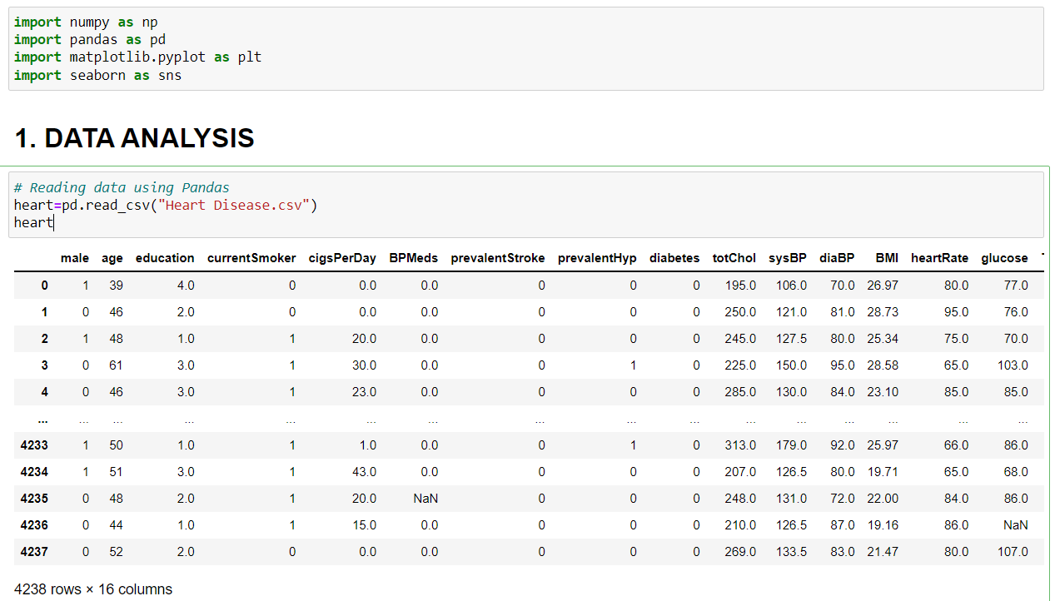
Importing the important packages & reading the dataset:

Slide 10
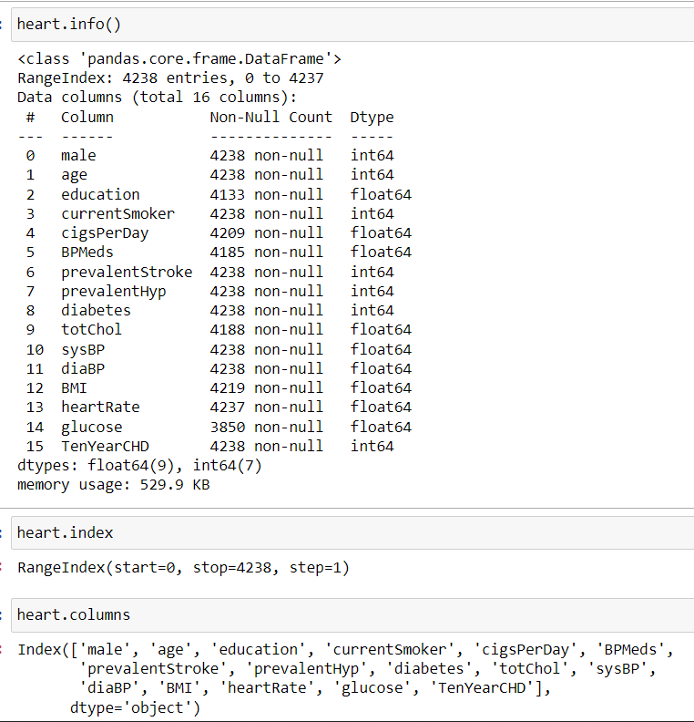
Information of table, index and columns

Slide 11
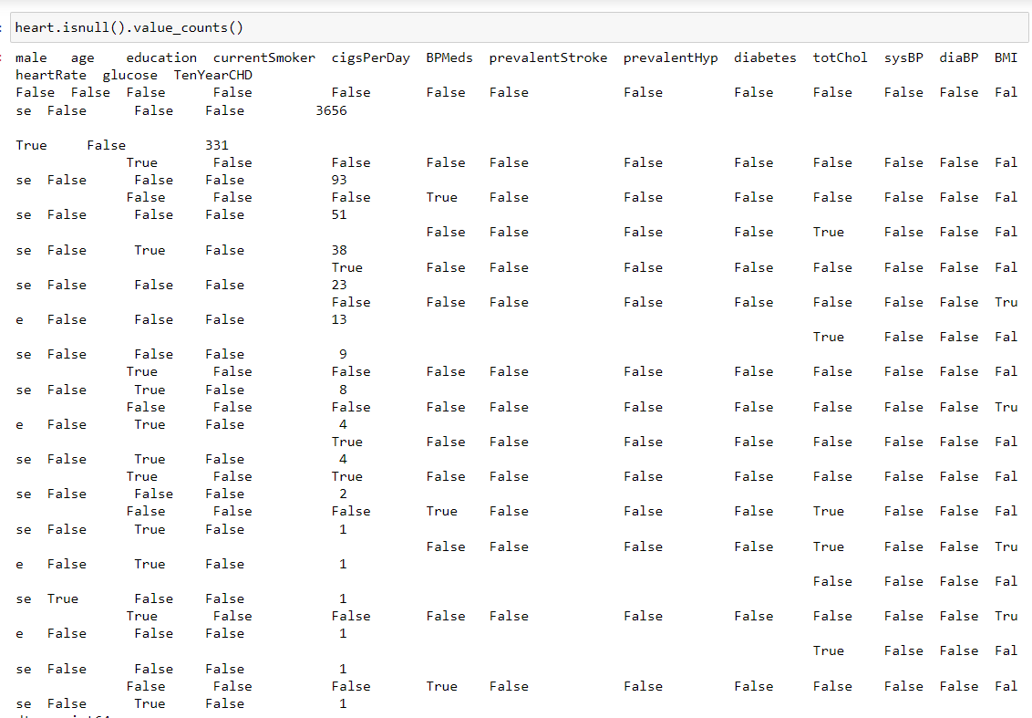
Isnull function to find null blocks

Slide 12
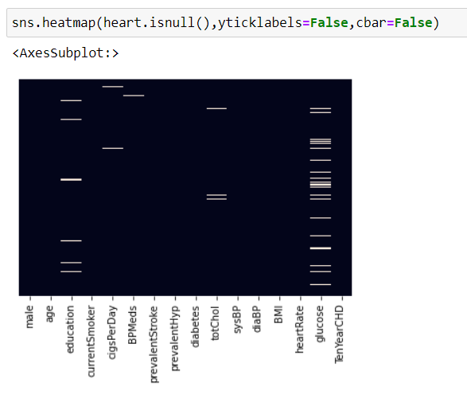
Isnull heatmap to find null values

Slide 13
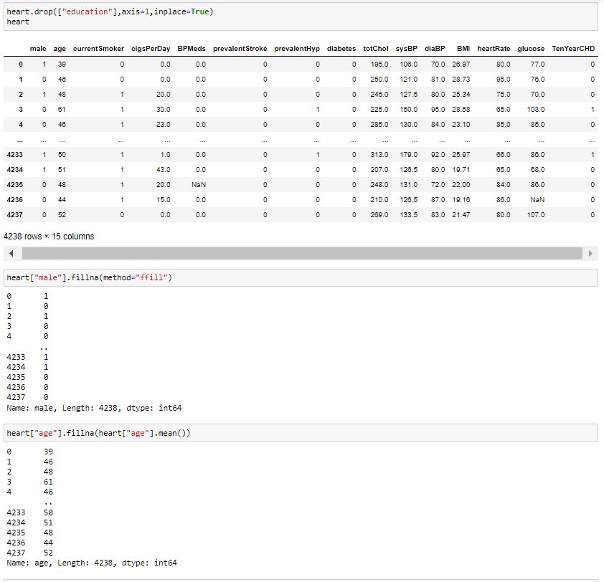
Dropping column and filling the empty blocks

Slide 14
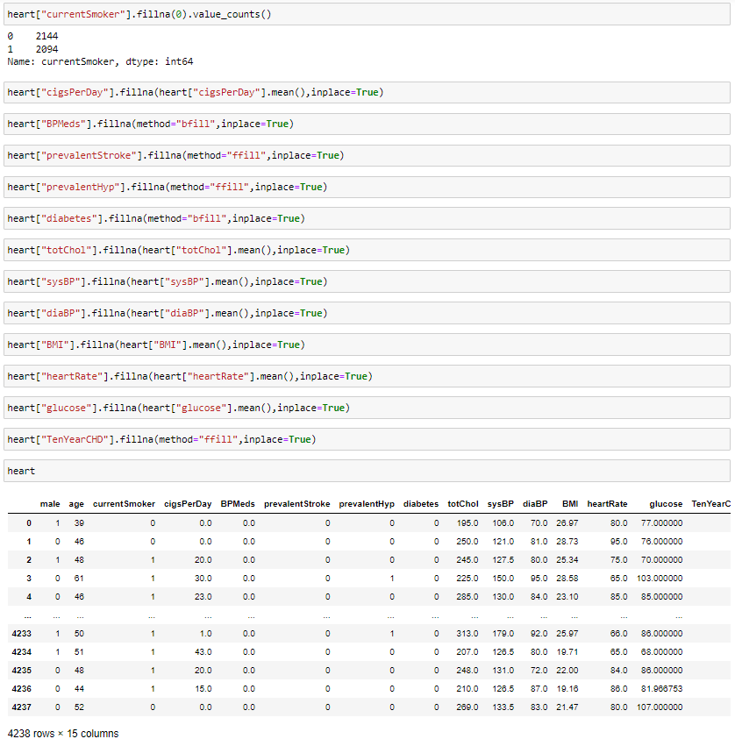
Filling the empty spaces

Slide 15
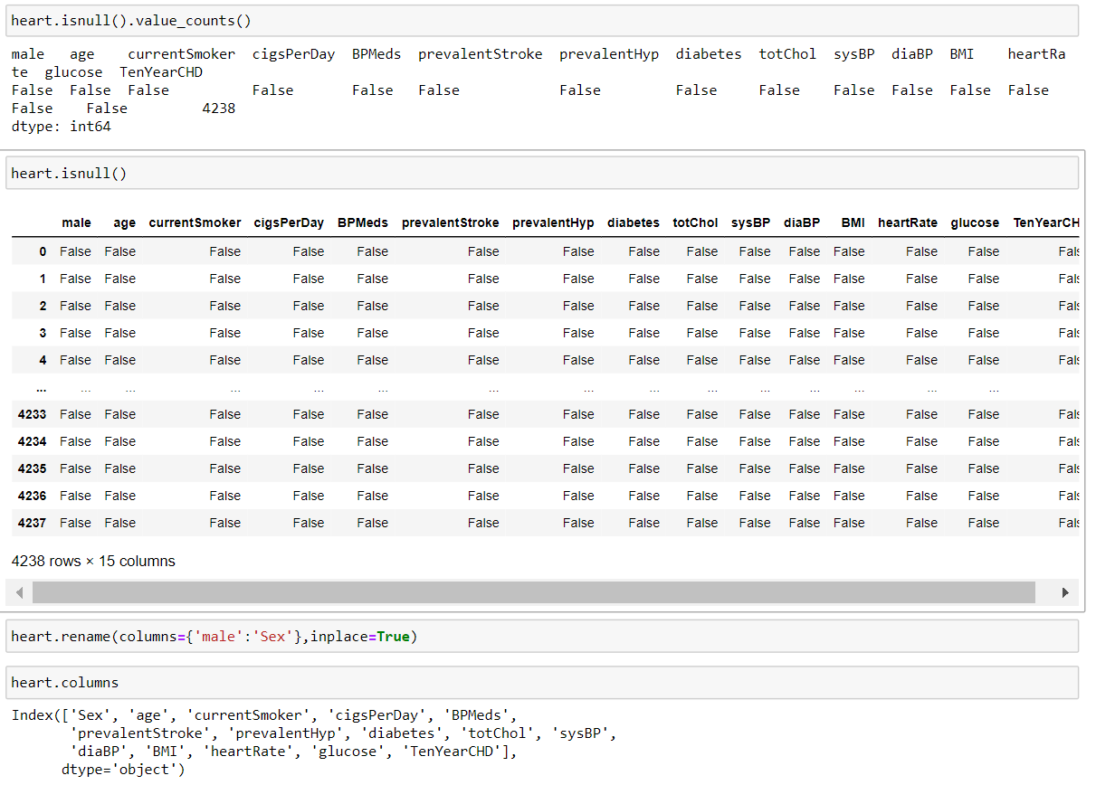
Cross-checking the filled null values and renaming columns

Slide 16
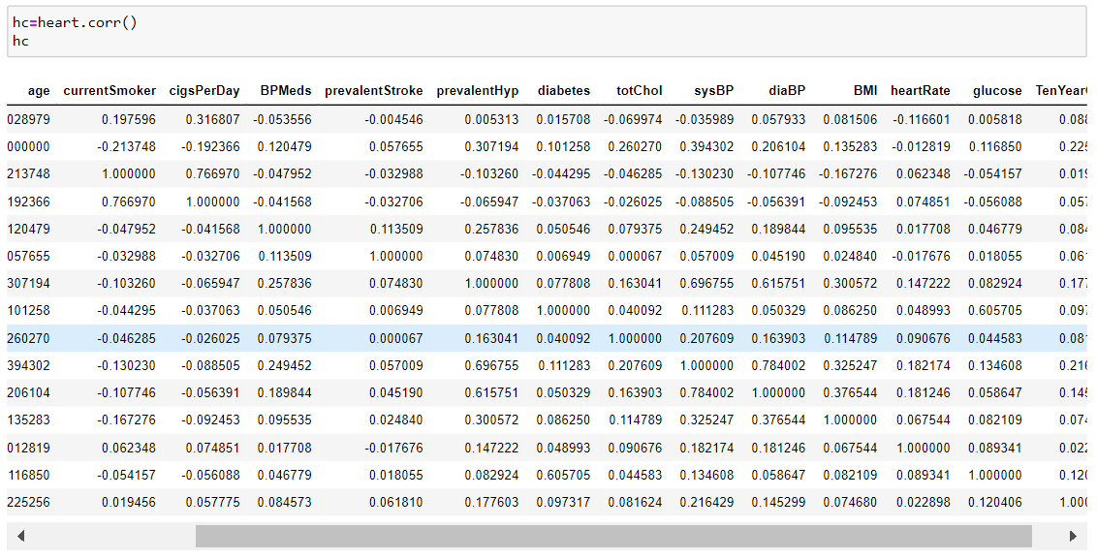
Finding the correlation coefficient of the table

Slide 17
DATA VISUALIZATION
Concepts involved in Data Visualization:
Matplotlib – Matplotlib is the most popular plotting library for Python. It gives you control over every aspect of a figure.
Heatmap – It is often desirable to show data which depends on two independent variables as a color coded image plot. This is often referred to as a heatmap. If the data is categorical, this would be called a categorical heatmap.
Pairplot – A pairplot plot a pairwise relationships in a dataset. The pairplot function creates a grid of Axes such that each variable in data will by shared in the y-axis across a single row and in the x-axis across a single column.
Distplot - A Distplot or distribution plot, depicts the variation in the data distribution. Seaborn Distplot represents the overall distribution of continuous data variables.
Jointplot - A Jointplot comprises three plots. Out of the three, one plot displays a bivariate graph which shows how the dependent variable(Y) varies with the independent variable(X). Another plot is placed horizontally at the top of the bivariate graph and it shows the distribution of the independent variable(X).

Slide 18
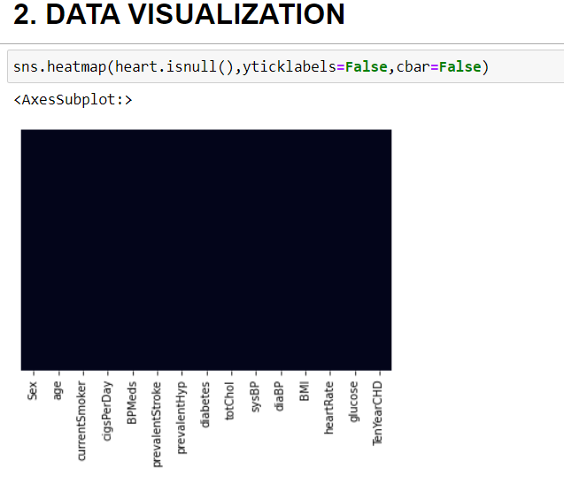
Heatmaps
To check any null value is there:

Slide 19
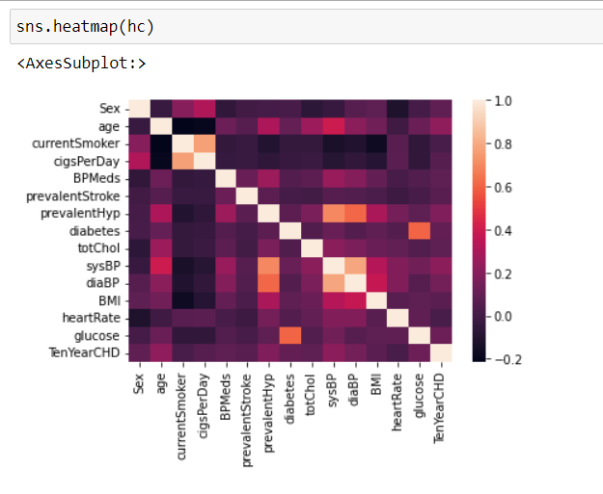
Heatmap of the corr table:

Slide 20
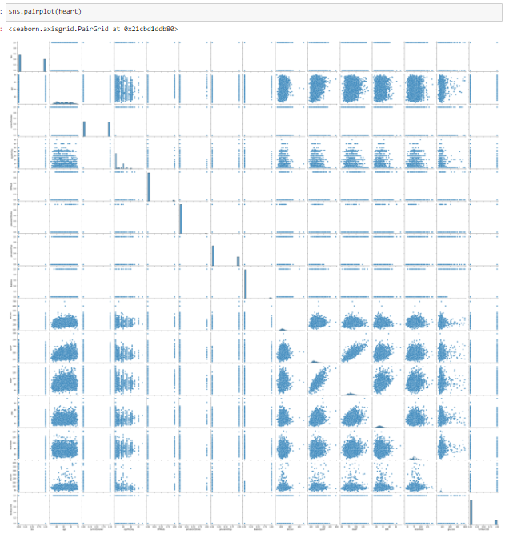
Pairplot

Slide 21
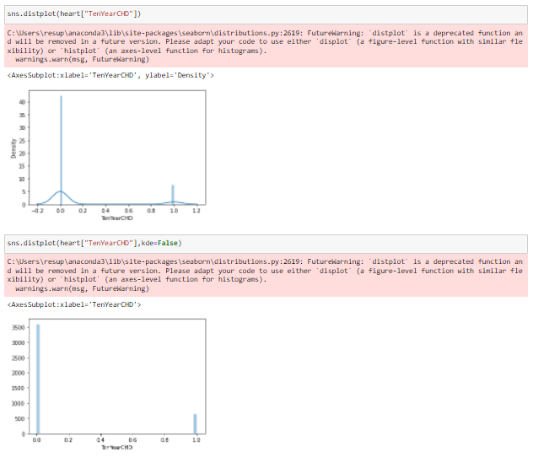
Distplot

Slide 22
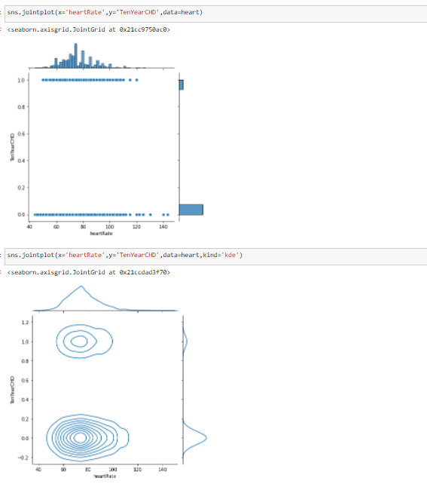
Jointplot

Slide 23
MODEL BUILDING
Machine Learning Model:
Logistic Regression: Logistic Regression is one of the most popular Machine Learning algorithms, which comes under Supervised Machine Learning technique.
→ It is used for predicting the categorical dependent variable using a given set of independent variables.
→ Logistic regression predicts the output of a categorical dependent variable.

Slide 24
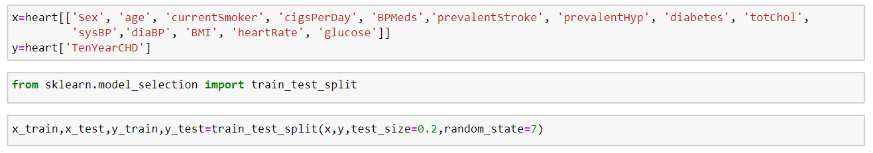
Defining x and y values and training the dataset using sklearn Package

Slide 25
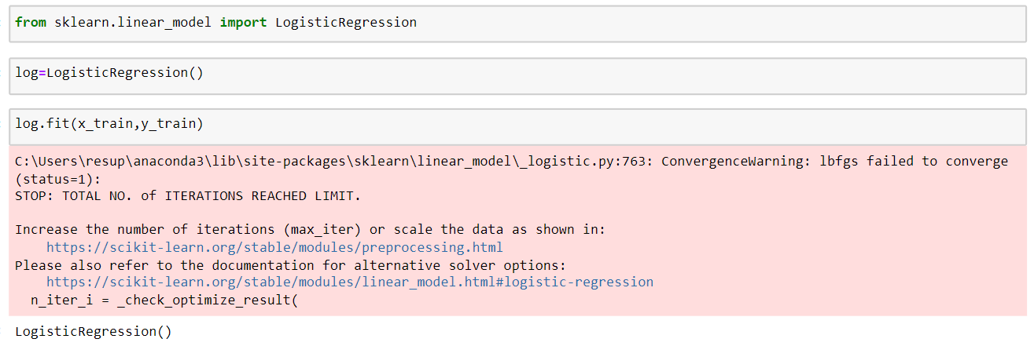
Importing Logistic Regression using sklearn

Slide 26
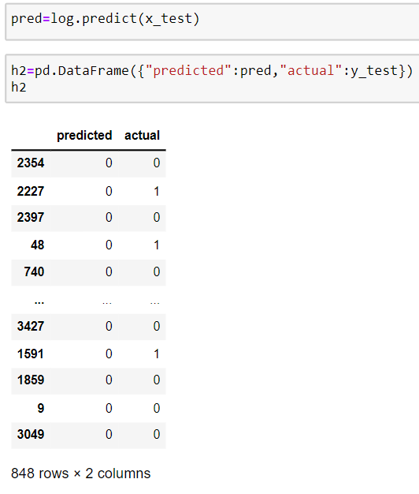
Predicting the trained data and comparing it with actual

Slide 27
PREFORMANCE EVALUATION OF THE MODEL
Accuracy- it is the ratio of correct prediction divided by the total no. of predictions

Slide 28
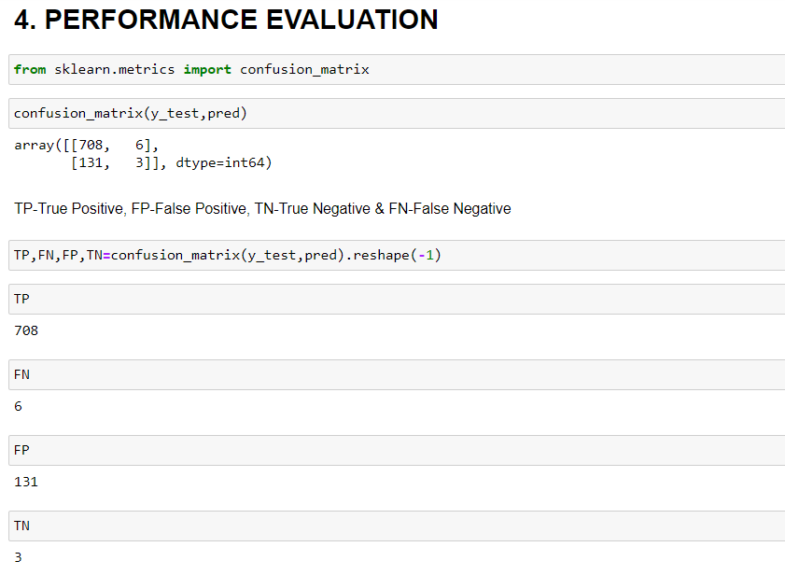
Importing Confusion Matrix from sklearn and finding the values TP, FP, TN, FN

Slide 29
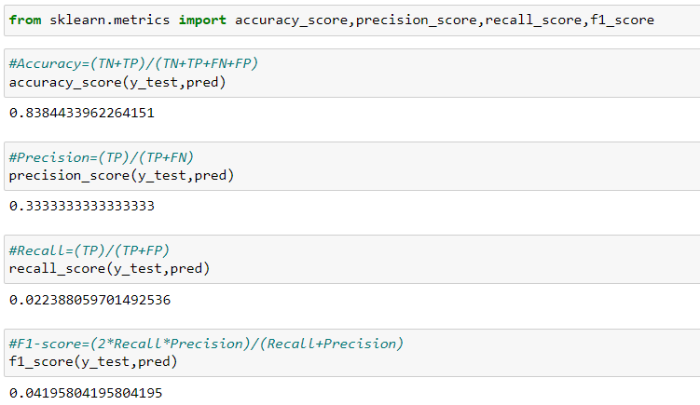
Finding Accuracy, Precision, Recall and F1 score

Slide 30
CONCLUSION
On performing all the processes like Data Cleaning/Preperation, Data Visualization, building model, Performance Evaluation of that model, we can conclude that this model’s accuracy came out to be 0.83 i.e. 83%.
As it is above 75% accuracy, which is the main requirement to consider a model as the performing model, can be considered as the predicting the Heart diseases using this Machine Learning Algorithm.

Slide 31
REFERENCE
We referred Kaggle for the dataset and information related to it.
Link - https://www.kaggle.com/code/neisha/heart-disease-prediction-using-logistic-regression

Slide 32
THANK YOU

